Slide 1


Electrical Science
By
Dr. Manoj Kumar
University School of Automation and Robotics
GGSIP University, East Campus, Delhi, India
Lecture
AC Generator and Motor
1

Slide 2
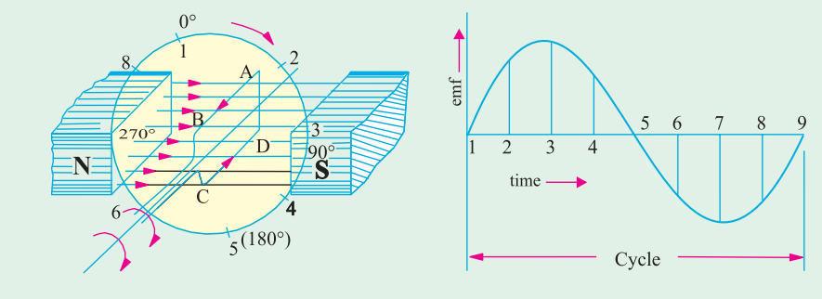
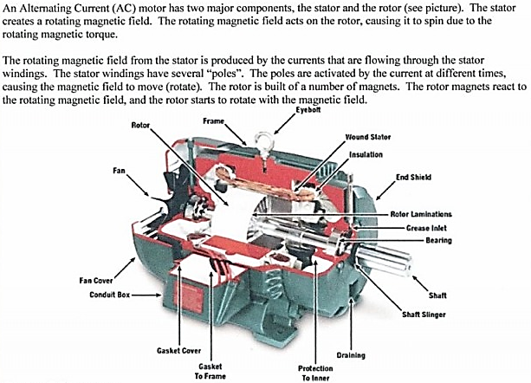
AC Generator

Slide 3
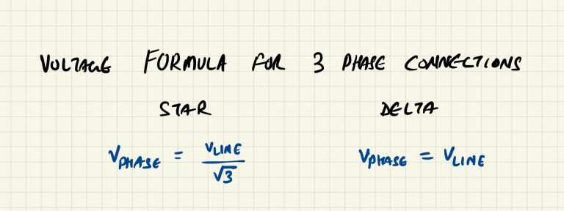
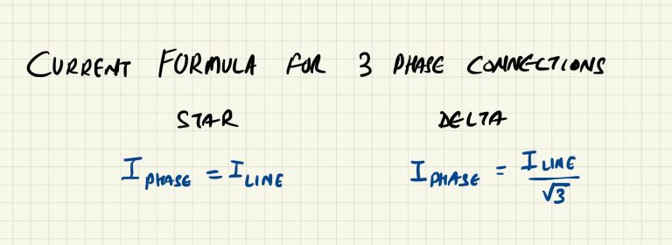
Practical AC Generator
Q1. Which type of motor connection will have different line and phase voltages?
Star Connection has Different Line and Phase voltages
The line voltage will be the same whether the connection is Star or Delta. The change happens in the phase voltage when the motor terminals are connected in a certain way.
the phase voltage of Delta connected motor is the same as the line voltage, whereas the phase voltage of the same motor, when connected in Star, will show a smaller voltage.

Slide 4
Practical AC Generator
Which type of motor connection will have different line and phase currents?
Delta Connection has Different Line and Phase Currents
the line currents for motors will change based on several factors. For example, the motor’s power, load on the motor, power factor, motor connection type, etc.
Assuming: motor running at no load
the line and phase currents of the Star-connected motor will be the same, whereas, in the Delta-connected motor, they will be different.

Slide 5
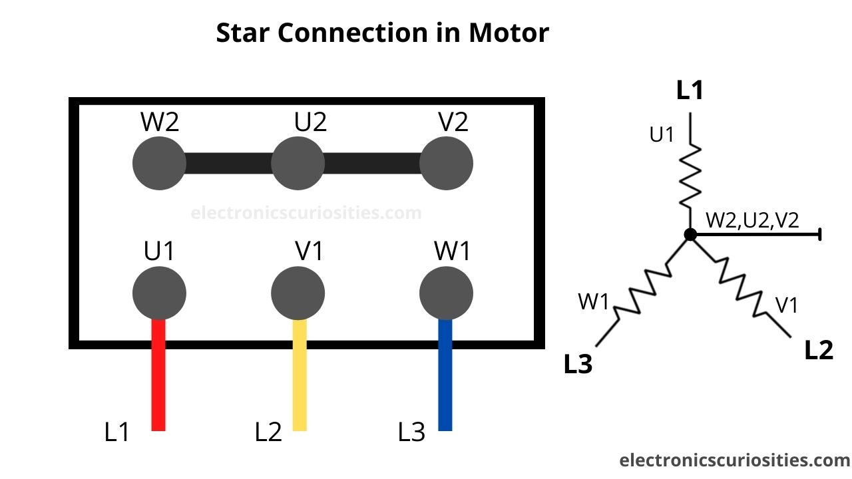
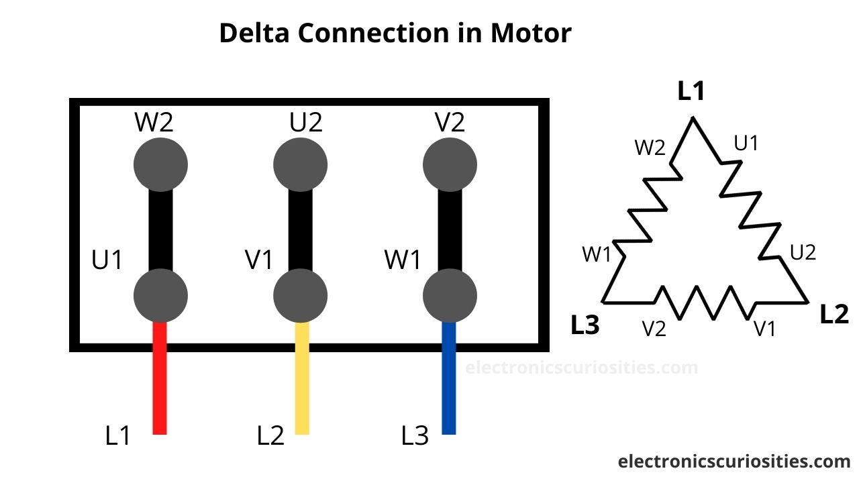
Practical DC Generator
Which type of motor connection will provide a higher motor torque?
Star Connected Motor will draw Less Starting Current.
since the motor is the same, but the voltage is less across the phases when connected in Star, the phase current will also be less. Contrary to the Delta connection, where the line current is higher than the phase current, in the Star connection, both line and phase currents are the same.
One of the reasons why Star-Delta starters are used is because of the less starting current in the Star connection stage, which provides less starting torque and puts less mechanical and electrical stress on the system, thereby increasing its lifespan.
So if a motor is connected in Star, it’ll draw less starting current than if the same motor is connected in Delta.

Slide 6
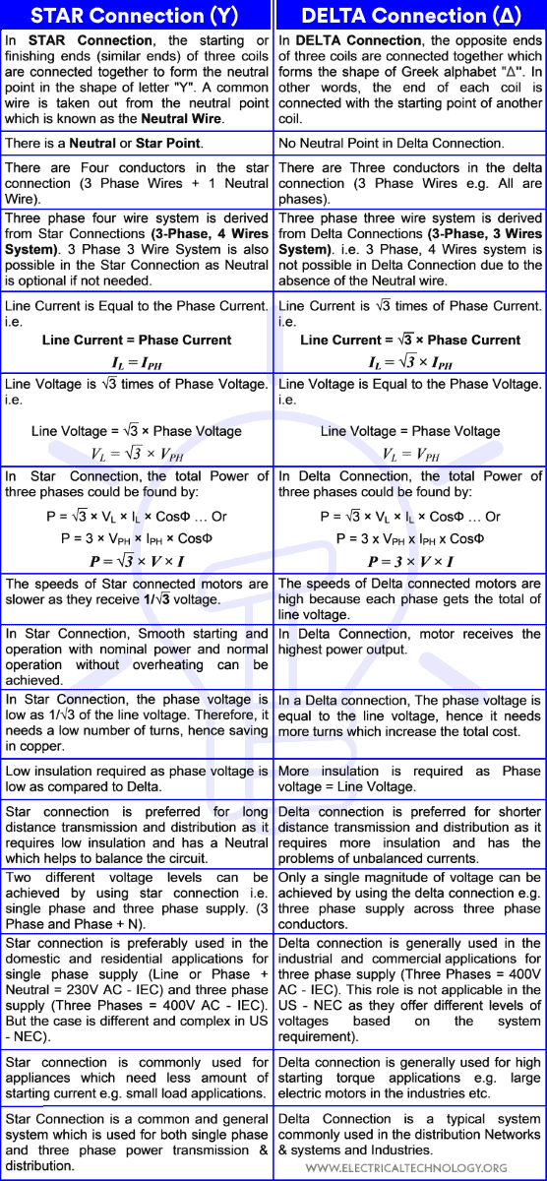
Practical AC Generator

Slide 7
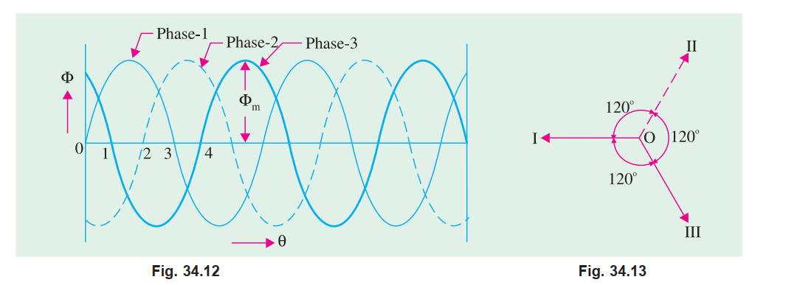
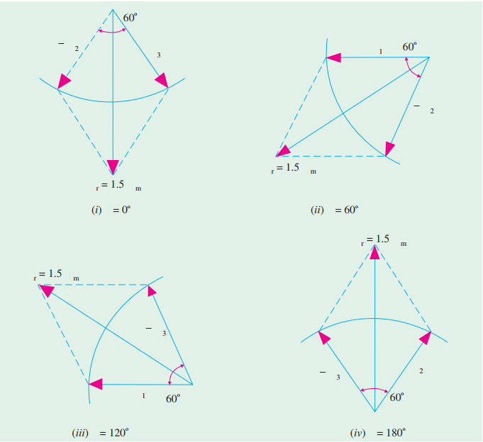
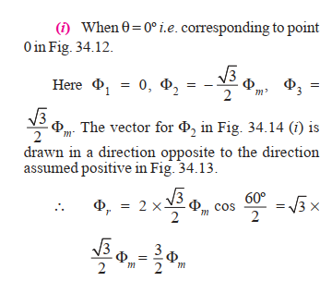
Practical AC Generator

Slide 8
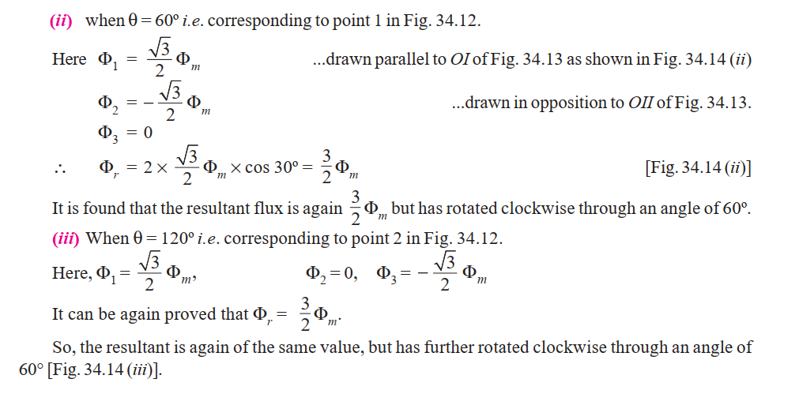
Practical AC Generator

Slide 9
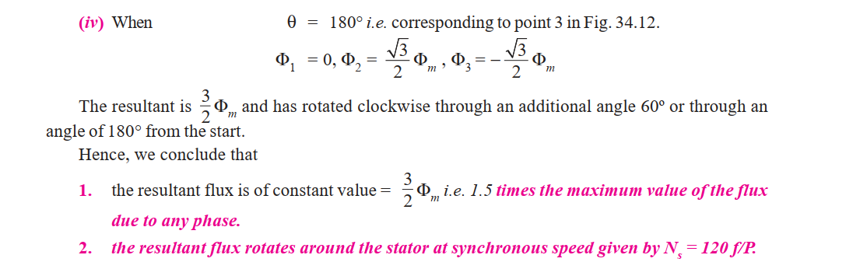
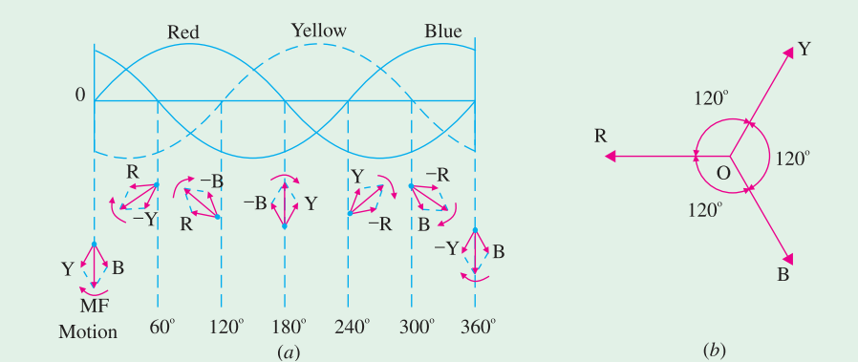
Practical AC Generator
Arrows on these flux phasors are reversed when each phase passes through zero and becomes negative.

Slide 10
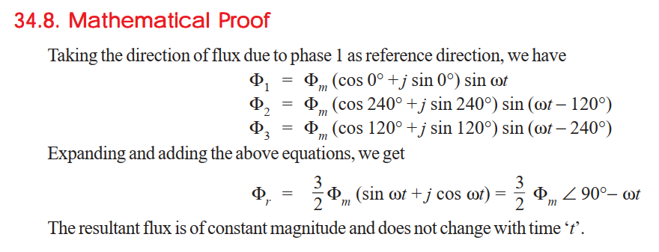
Practical AC Generator

Slide 11
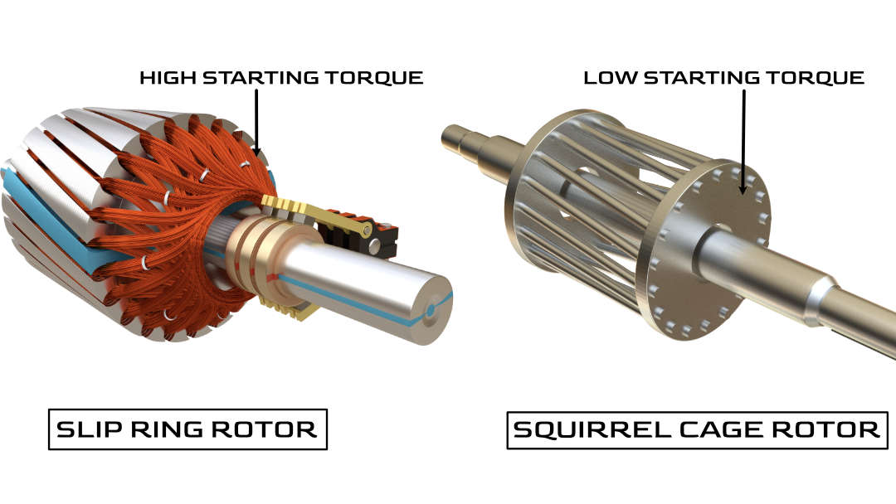
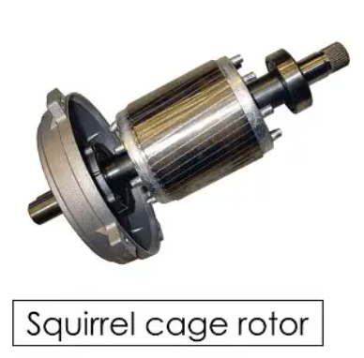
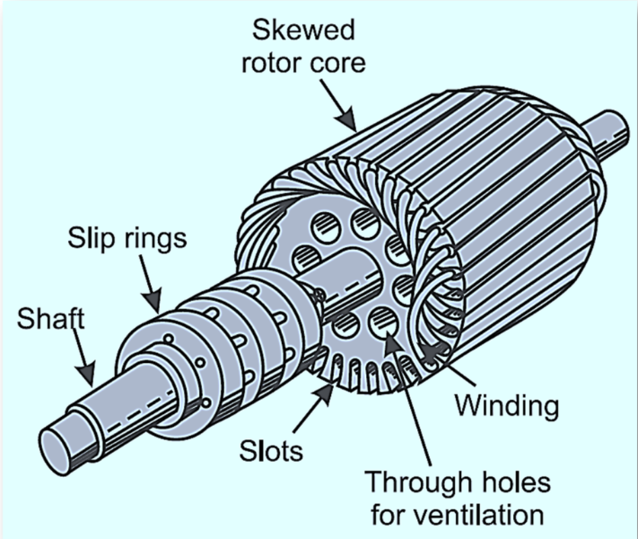
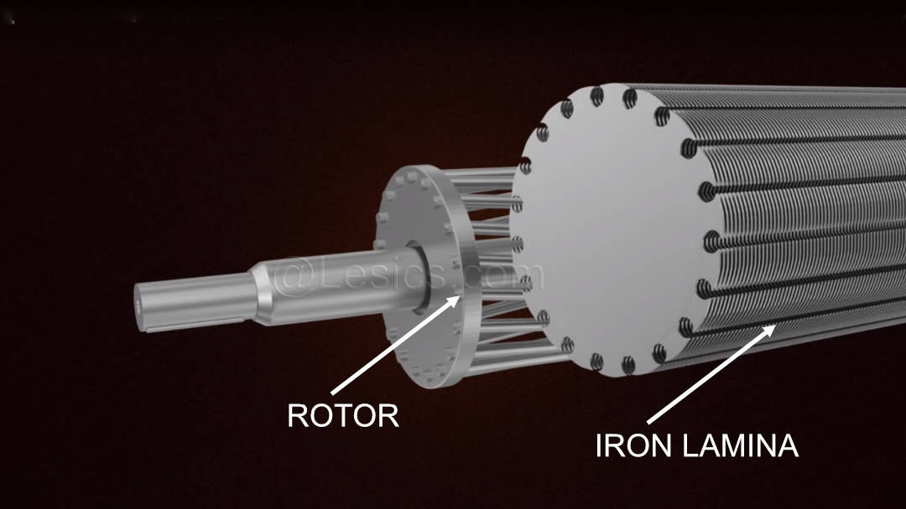
Squirrel Cage and phase wound rotor
It is in these circumstances that slip ring induction motors are used, as they produce high starting torque
squirrel cage type motors, produce a very low starting torque, and for some applications, this low starting torque causes a huge problem.

Slide 12
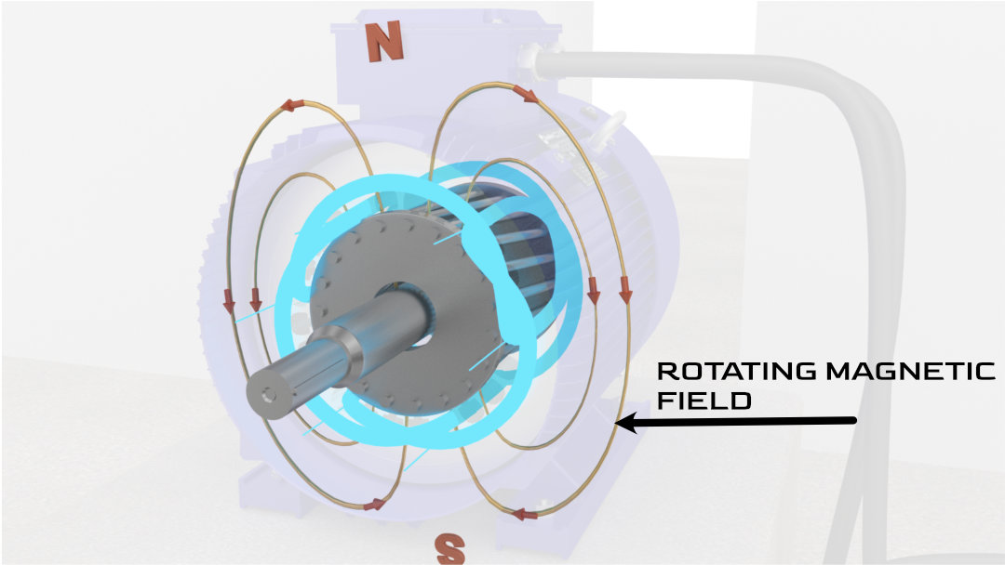
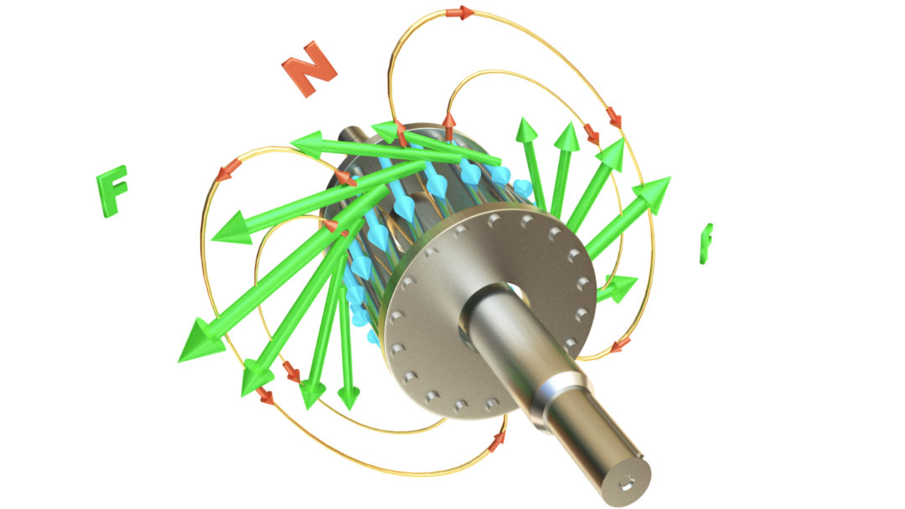
Torque in 3-Phase AC MOTOR
one big advantage of 3 phase induction motors, as it is inherently self starting.
It is in these circumstances that slip ring induction motors are used, as they produce high starting torque
According to Faraday's law of electromagnetic induction, an electromotive force is induced in the bars.
Because the rotor bars are short-circuited by the end rings, this induced EMF generates a current to flow through the rotor bars.
According to Lorentz’s law, when a current carrying conductor is placed in a magnetic field it will experience a force.
These collective forces make the rotor turn.

Slide 13
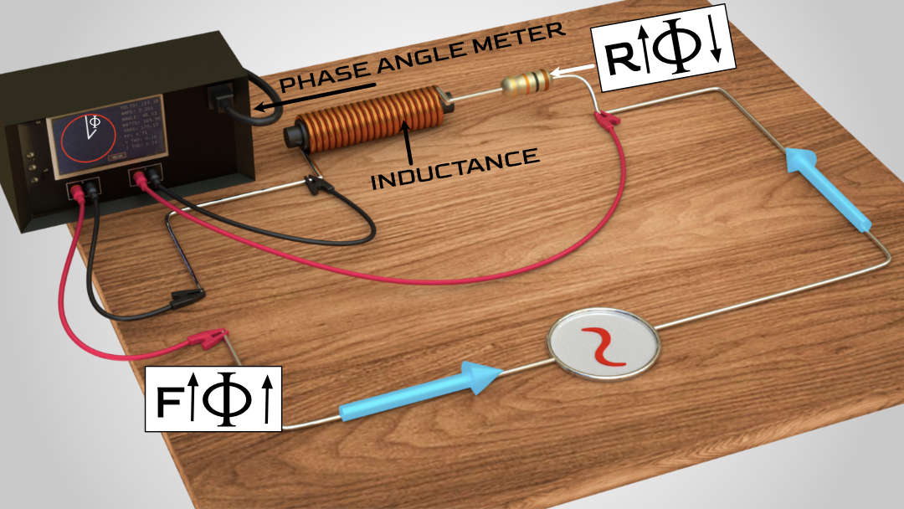
Squirrel Cage as a L-R circuit
The current flowing through the circuit is not in phase with the applied voltage. This is because of the presence of inductive reactance in the circuit. The higher the frequency of the electricity, the greater will be the inductive reactance and the phase difference. A higher resistance value reduces this phase difference.

Slide 14
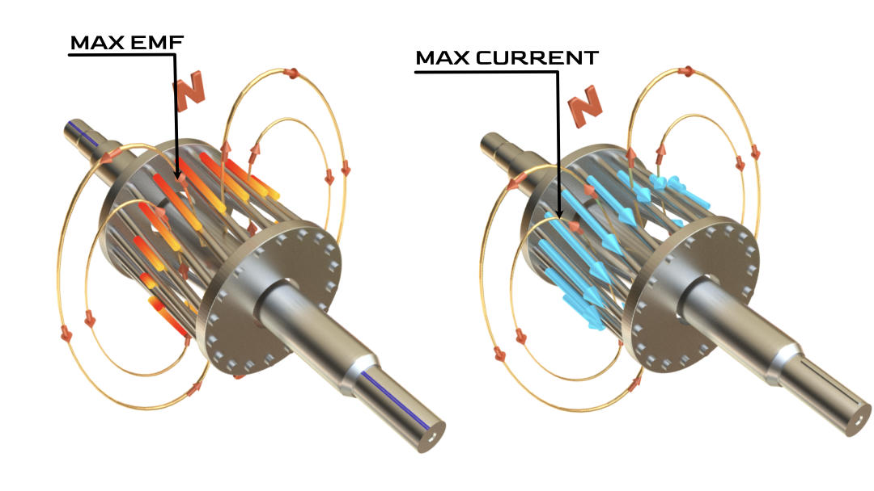
EMF and Current in 3-Phase AC MOTOR
The exact same thing is also happening in the rotor. The rotor is a combination of resistance and inductive reactance. Due to the same phase lag phenomenon, if the maximum EMF is on one bar, then the maximum current is on another bar

Slide 15
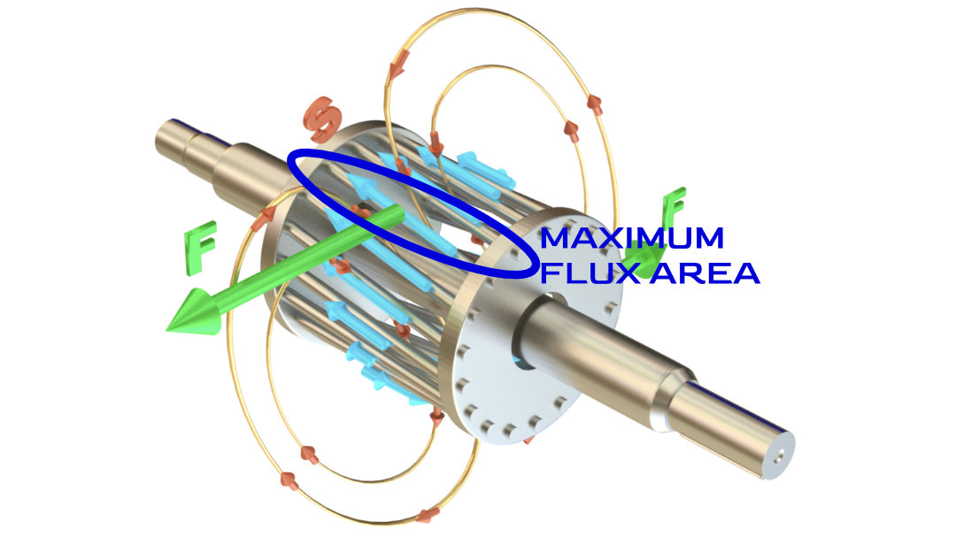
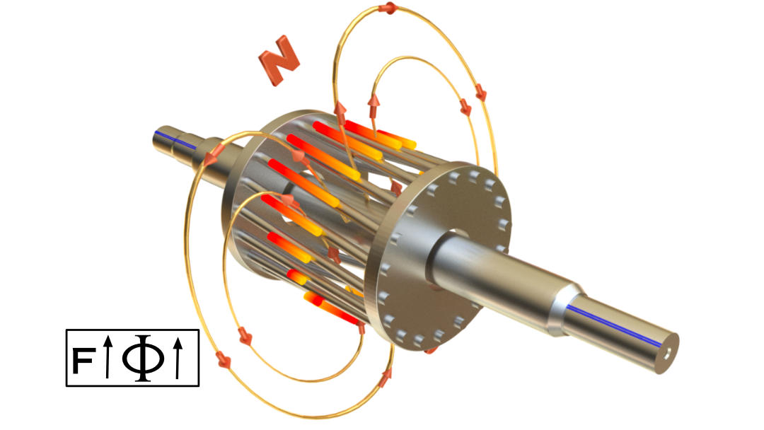
The maximum torque condition
An induction motor produces maximum torque when the maximum current is induced on the rotor, is near to the maximum magnetic flux.
As the current induced does not meet the ‘maximum torque condition’, this will definitely reduce the amount of torque produced by the induction motor. This phase difference will be high as the motor starts.
When starting the motor, the rotor speed is zero. Due to this, the magnetic field cut through the rotor at a very high rate and the frequency of the induced EMF will be high. This leads to the high inductance and phase difference, which causes the very low starting torque of a normal induction motor

Slide 16
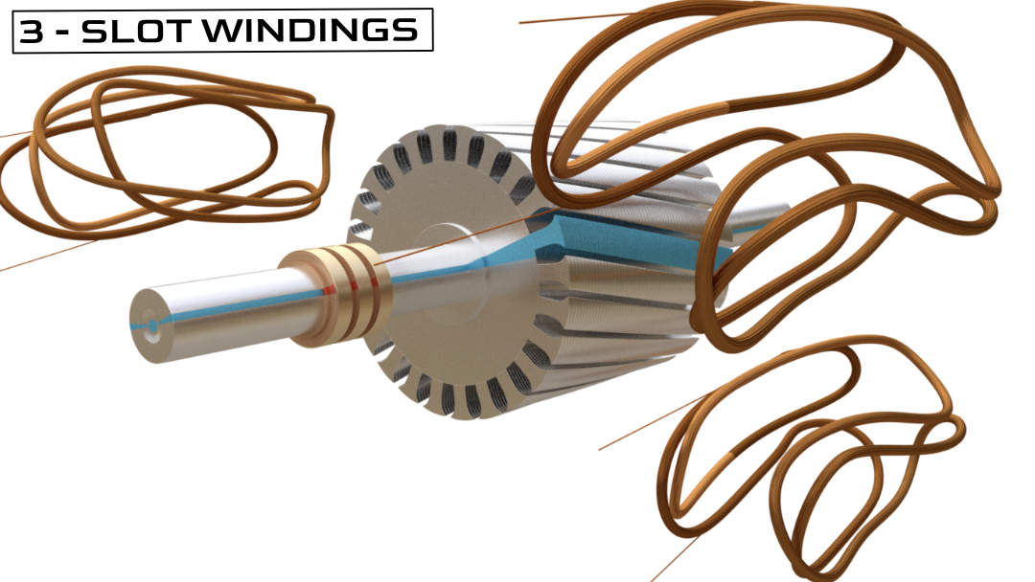
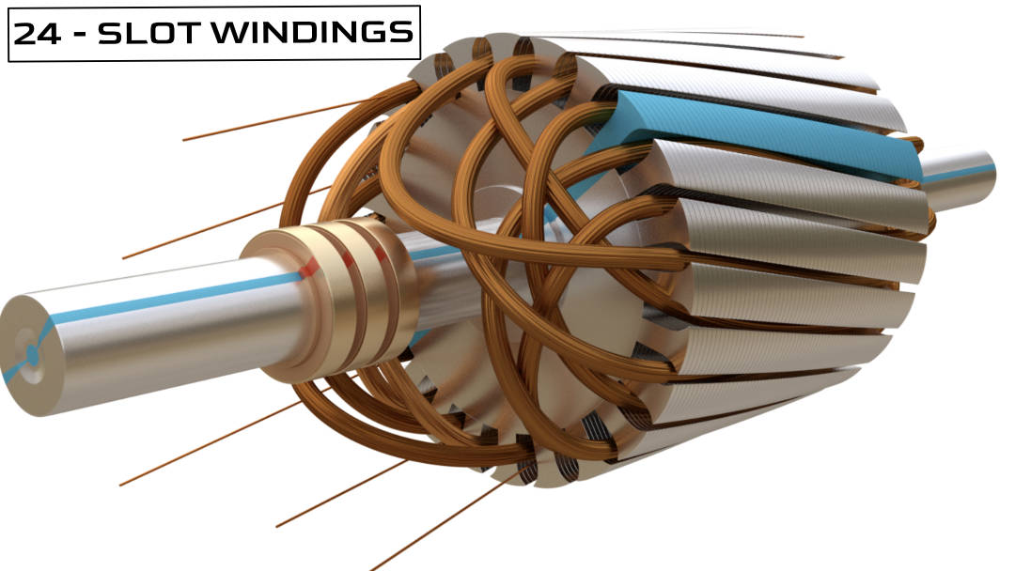
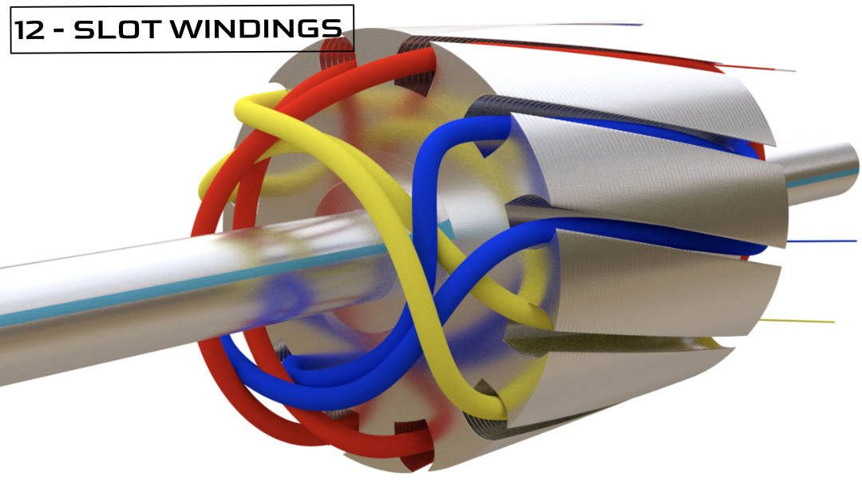
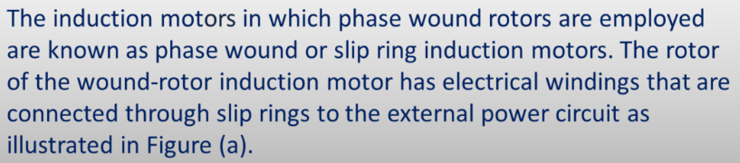
Slip ring/ wire wound AC motor
To overcome this problem the slip ring induction motor comes into the picture. The working principles and stator construction of the slip ring induction motor are exactly the same as that of the squirrel cage motor. However, the rotor construction of the slip ring motor is quite interesting.
This construction of the rotor is aimed at reducing the phase difference

Slide 17
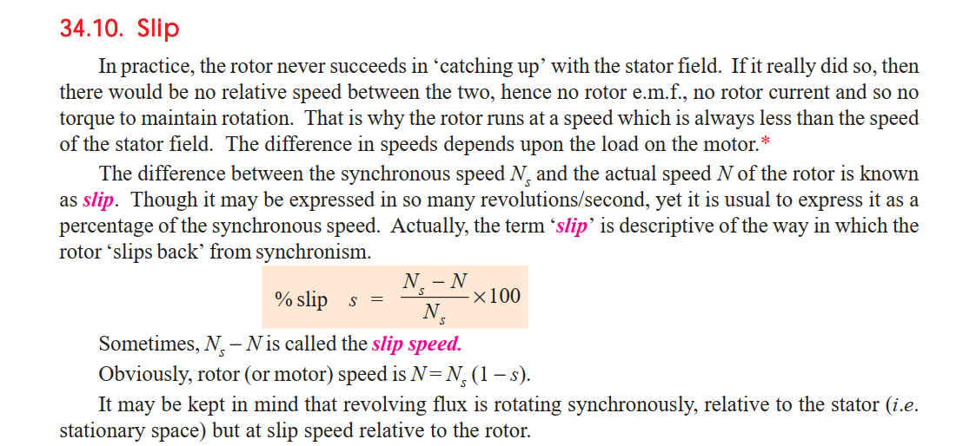
Slip in AC Motor

Slide 18
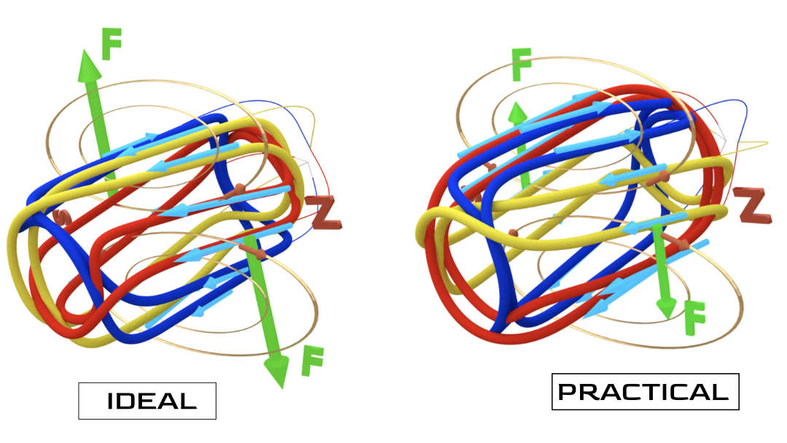
wire wound AC motor
Here again, the RMF induces EMF across the terminals of the windings. Let’s join the winding ends in a star connection and again assume that the inductive reactance is zero. The current flow established in the winding as shown in fig below. However, in practice, the current flow will be lagging behind the induced EMF. Here again the ‘the maximum torque condition’ is not met

Slide 19
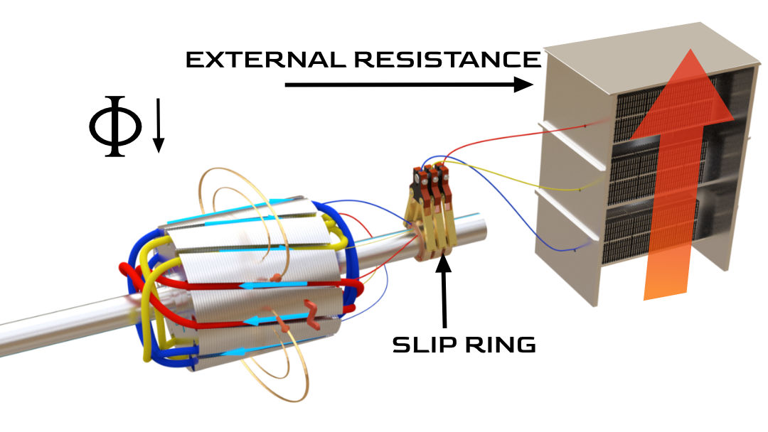
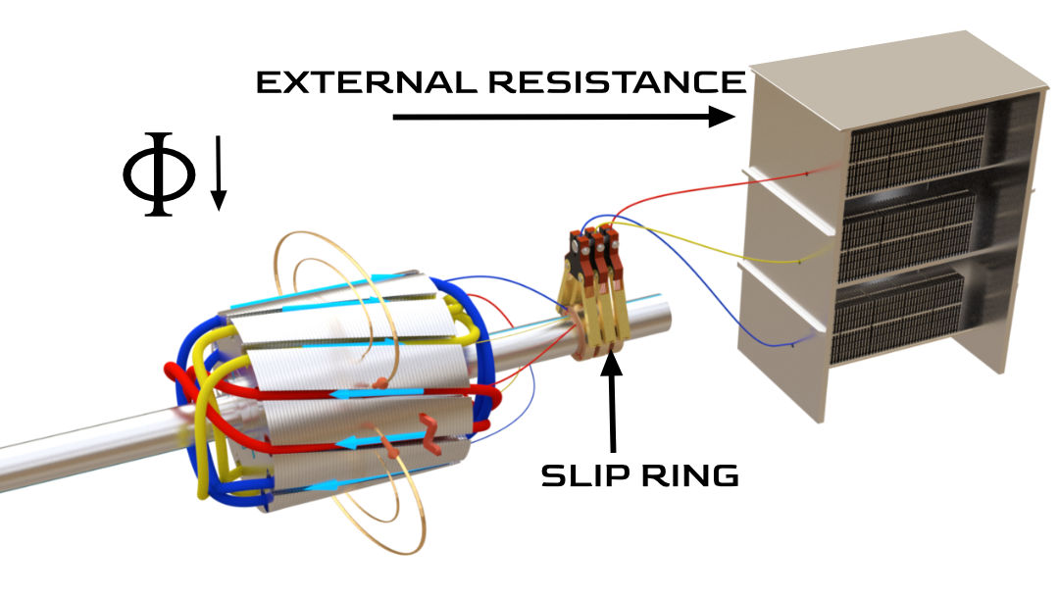
wire wound AC motor with external Resistance
In the slip ring induction motor, there is an option to reduce this EMF current phase difference, by use of external resistance. The other ends of the coils are connected to an external resistance via the slip rings (refer Fig 10). We saw in the simple circuit that by increasing the resistance value we can decrease that phase difference. As a slip ring induction motor starts, the external resistance value is increased

Slide 20
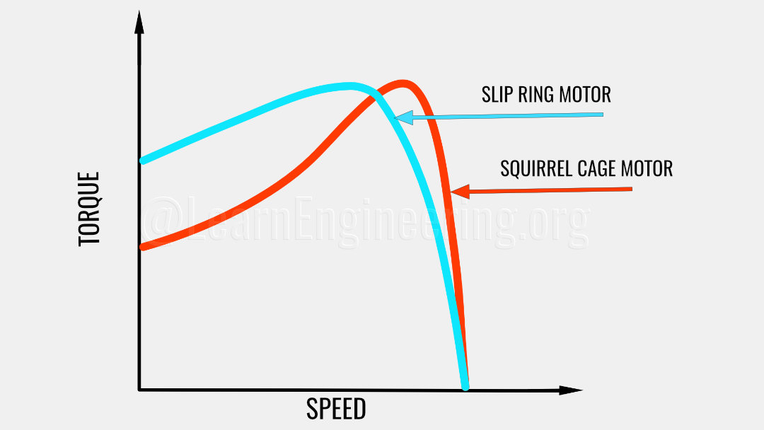
Squirrel Cage and phase wound torque comparison
This reduces the phase difference angle and the current induced approaches the ‘maximum torque condition’. This way slip ring induction motors are able to produce high torque even as they are starting.
Apart from the high starting torque, it also has some other advantages, and although slip ring induction motors have some disadvantages, they play a very important role in elevators, cranes, hoists and in industrial uses such as printing presses.
Notes:
Slip ring induction motor, how it works? (lesics.com)

Slide 21
Starting of Induction Motors
An induction motor is similar to a poly-phase transformer whose secondary is short circuited. Thus, at normal supply voltage, like in transformers, the initial current taken by the primary is very large for a short while. Unlike in DC motors, large current at starting is due to the absence of back emf. If an induction motor is directly switched on from the supply, it takes 5 to 7 times its full load current and develops a torque which is only 1.5 to 2.5 times the full load torque. This large starting current produces a large voltage drop in the line, which may affect the operation of other devices connected to the same line. Hence, it is not advisable to start induction motors of higher ratings (generally above 25kW) directly from the mains supply.

Slide 22
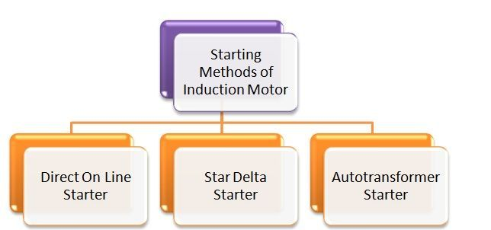
AC Motor Starters
There is a necessity to control the high currents during the starting of an induction motor as they will harm the nearby loads, hence we have to adopt suitable starting methods of induction motor to reduce the high starting currents. But while the motor runs at the rated speed, there is no issue with these inrush currents, as the motor attains the rated speed, the slip will come into play and the rotor current will be reduced. The most commonly used starting methods of induction motor are given below.
At the time of starting, the motor slip is unity, and the starting current is very large.

Slide 23
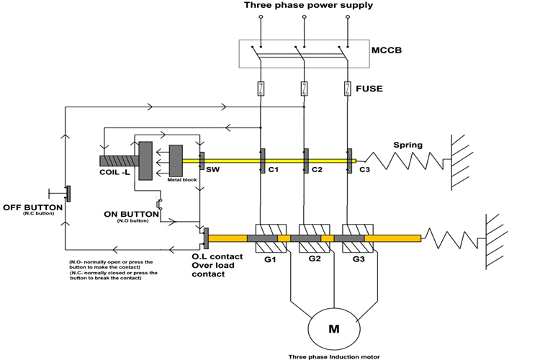
Direct Online Starter
Direct Online Starter is a mechanism that provides overload protection for three-phase squirrel cage induction motors.
The main functions provided by Direct Online Starter to Three-phase induction motor are:
Over-current protection or Short circuit protection.
Overload protection.
Isolated motor switching setup.
SW, C1, C2, and C3 Initially disconnected
Over-current protection or Short circuit protection: DOL starter consists of MCCB (circuit breaker) and fuse setup to disconnect the motor from the supply in case of a short circuit.
Overload protection: DOL starter consists of an electro-mechanical setup which will disconnect the motor from the power supply if the motor is overloaded or the motor draws current more than the rated value.
Isolated motor switching setup: Since high power motors are dangerous, the DOL starters are designed in a way that allows the customer to turn ON and OFF the motor indirectly.
Initially connected
Even after switching off/release the on button the coil is energized. SW,C1, C2, and C3 still connected

Slide 24
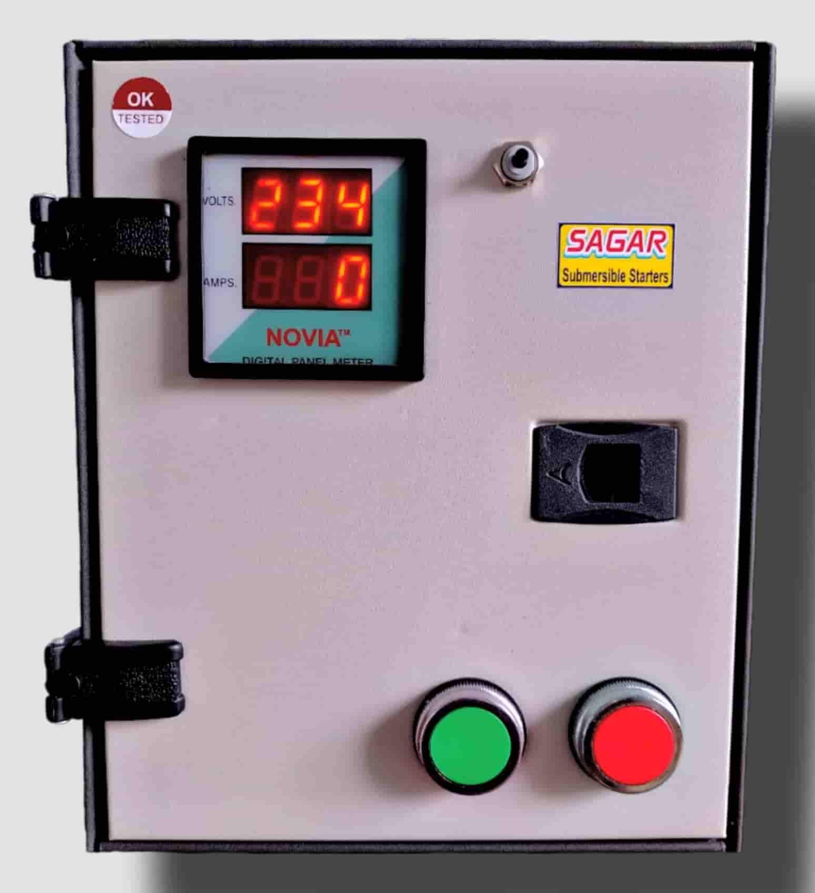
Direct Online Starter
The MCCB here will be selected to match the motor ratings and in case of any fault in connections or motor windings, this MCCB will trip immediately disconnecting the entire system from the main power line.
These fuses will blow up immediately in case of any short circuit and disconnect the motor from the power line.

Slide 25
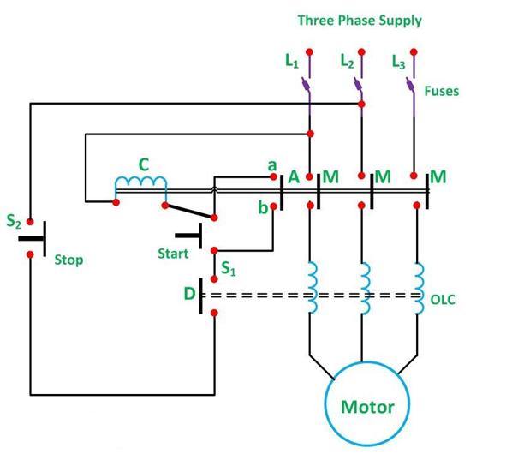
Direct Online Starter

Slide 26
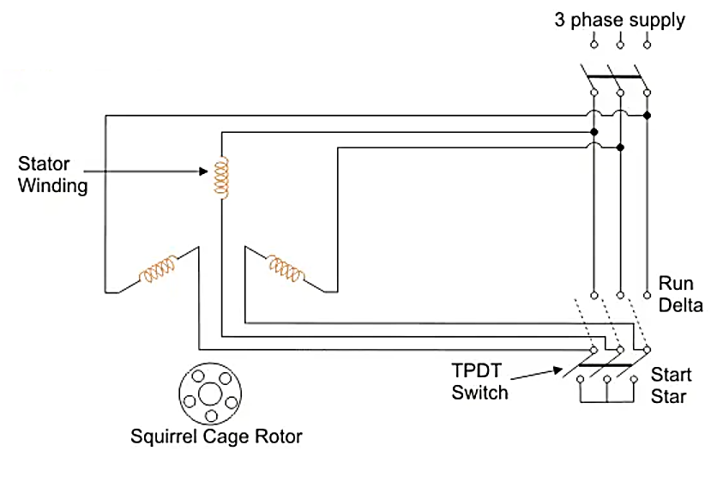
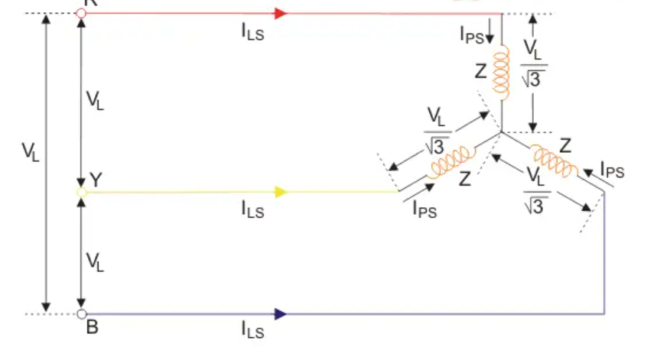
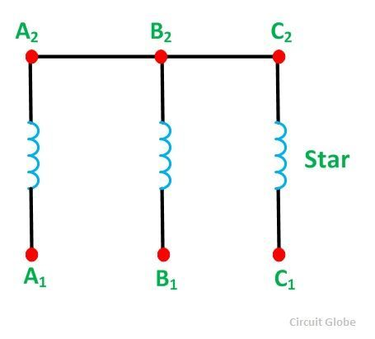
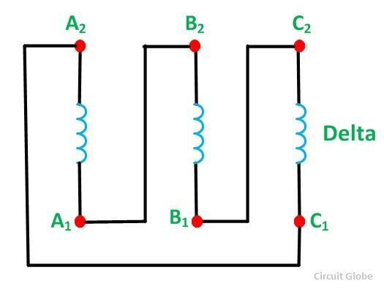
Star Delta Starter
The starter mainly consists of a TPDP switch which stands for Tripple Pole Double Throw switch. This switch changes stator winding from star to delta. During starting condition stator winding is connected in the form of a star. Now we shall see how a star delta starter reduces the starting current of a three-phase induction motor.

Slide 27
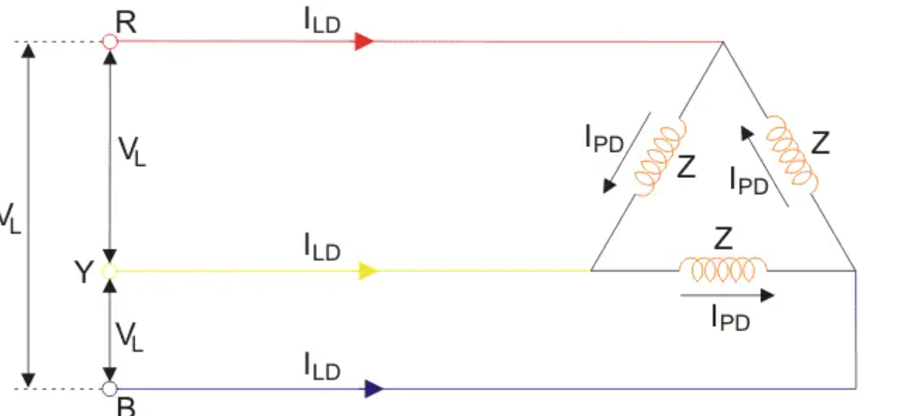
Direct Online Starter
Advantages of Star Delta Starter
The advantages of star delta starters include:
Inexpensive
No heat is produced, or tap changing device needs to be used, hence efficiency increases.
Starting current reduced to 1/3 of direct online starting current.
Produce high torque per ampere of line current.
Disadvantages of Star Delta Starter
The disadvantages of star delta starters include:
Starting torque is reduced to 1/3 of full load torque.
A particular set of motors required.

Slide 28
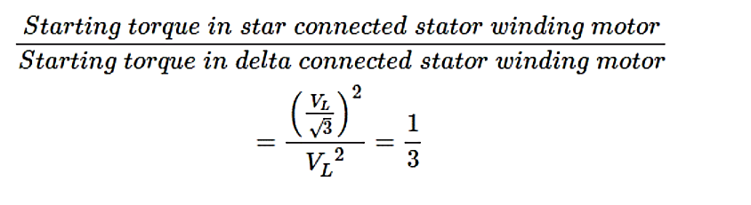
Direct Online Starter
The equation shows that star delta starter reduces the starting torque to one-third of that produced by DOL starter.

Slide 29
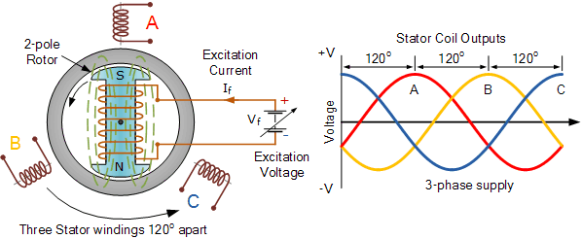
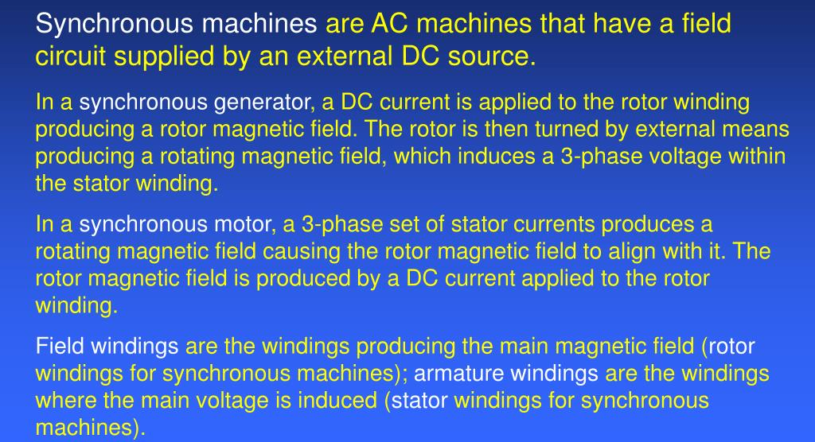
Synchronous Machines

Slide 30
Synchronous Machines
This rotor winding is connected to a DC supply voltage producing a field current, I_{f}.
The external DC excitation voltage which can be as high as 250 volts DC, produces an electromagnetic field around the coil with static North and South poles.
When the generators rotor shaft is turned by the turbines blades (the prime mover), the rotor poles will also move producing a rotating magnetic field as the North and South poles rotate at the same angular velocity as the turbine blades, (assuming direct drive).
As the rotor rotates, its magnetic flux cuts the individual stator coils one by one and by Faraday’s law, an emf and therefore a current is induced in each stator coil.
The magnitude of the voltage induced in the stator winding is, as shown above, a function of the magnetic field intensity which is determined by the field current, the rotating speed of the rotor, and the number of turns in the stator winding. As the synchronous machine has three stator coils, a 3-phase voltage supply corresponding to the windings, A, B and C which are electrically 120º apart is generated in the stator windings and this is shown above.

